Slide 1
BEST2SMB 24

Slide 2
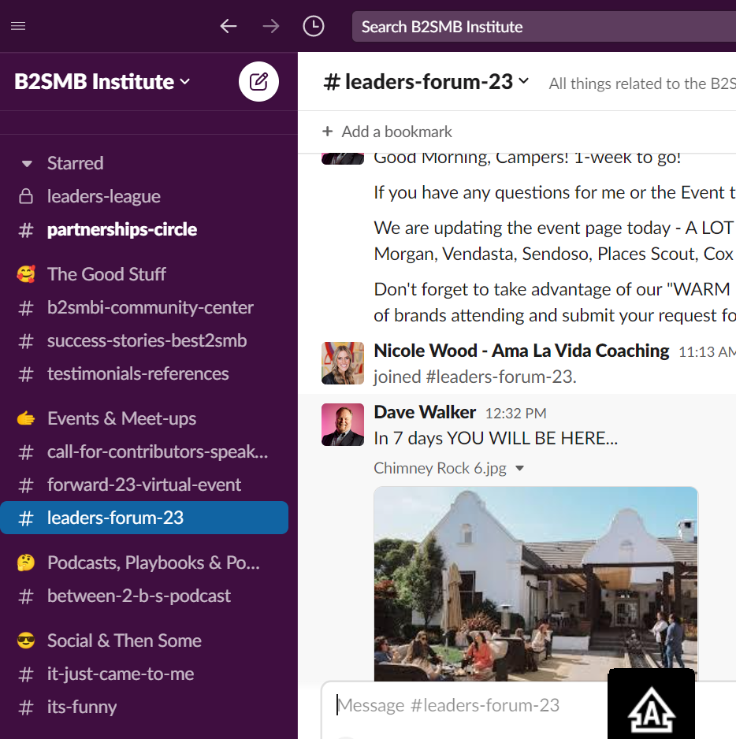
B2SMBI.slack.com
#best2smb-24

Slide 3
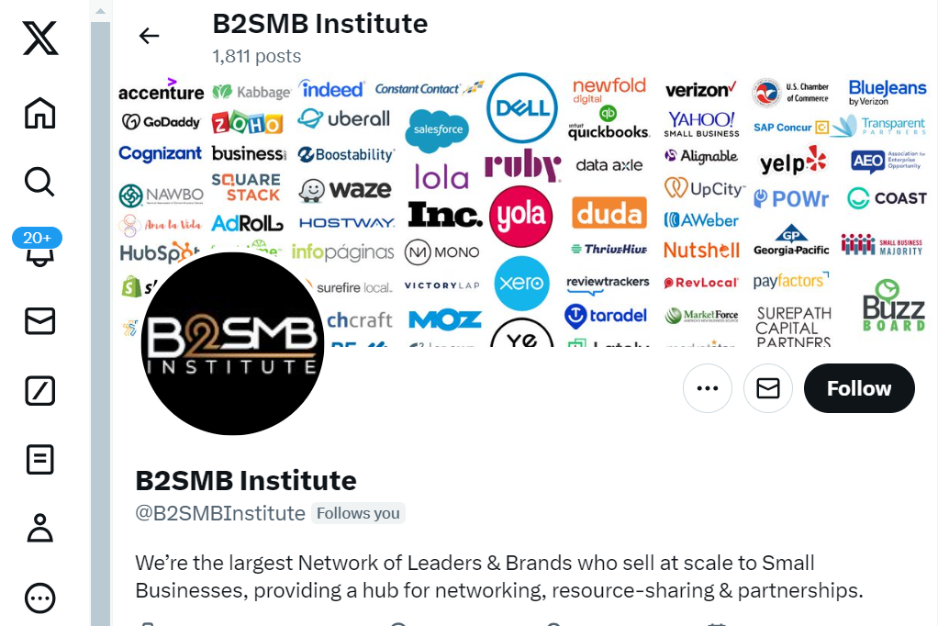
@B2SMBInstitute
#best2smb

Slide 4
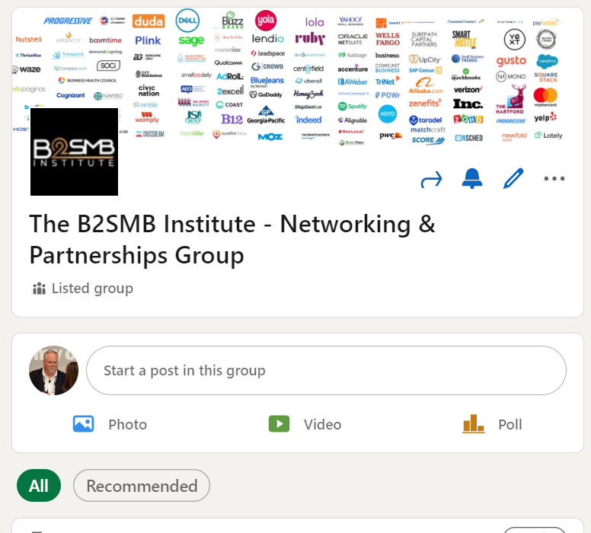
B2SMB Institute – Networking
& Partnerships Group

Slide 5
PARTNERSHIPS

Slide 6
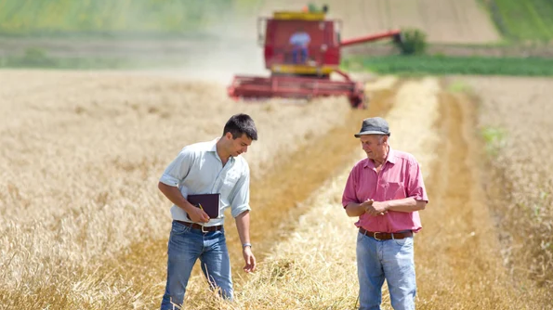

Slide 7
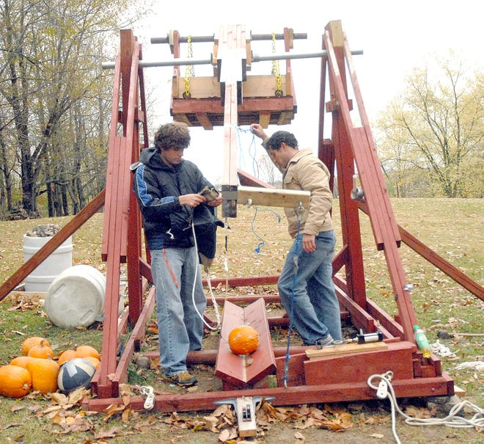

Slide 10
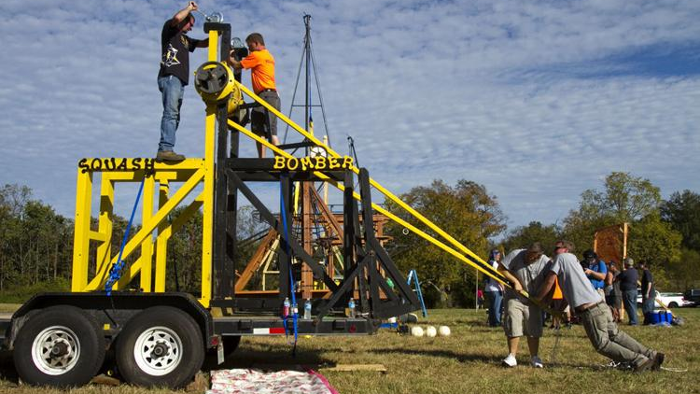

Slide 11
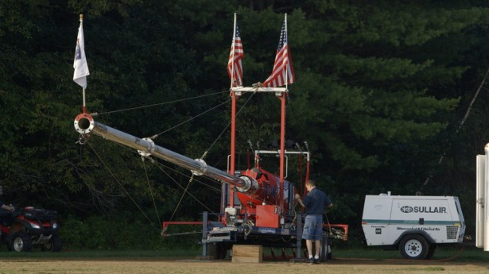

Slide 12
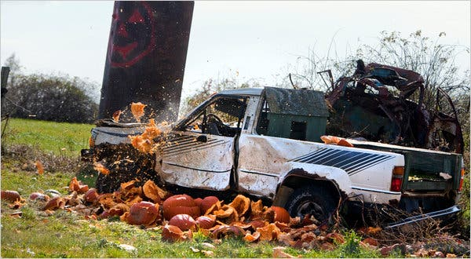

Slide 13
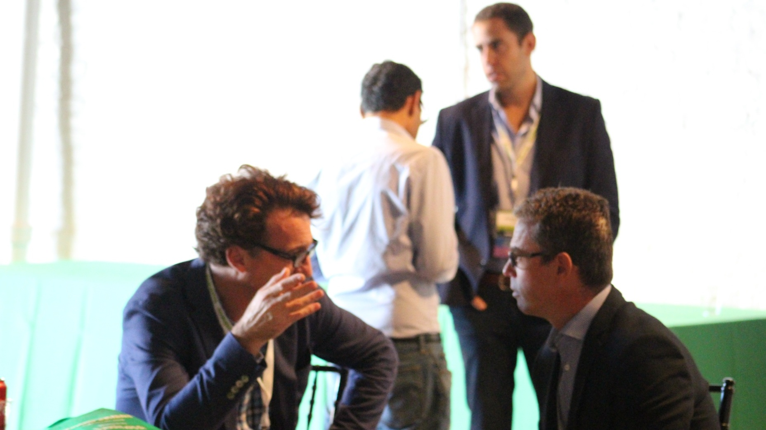
2017

Slide 14
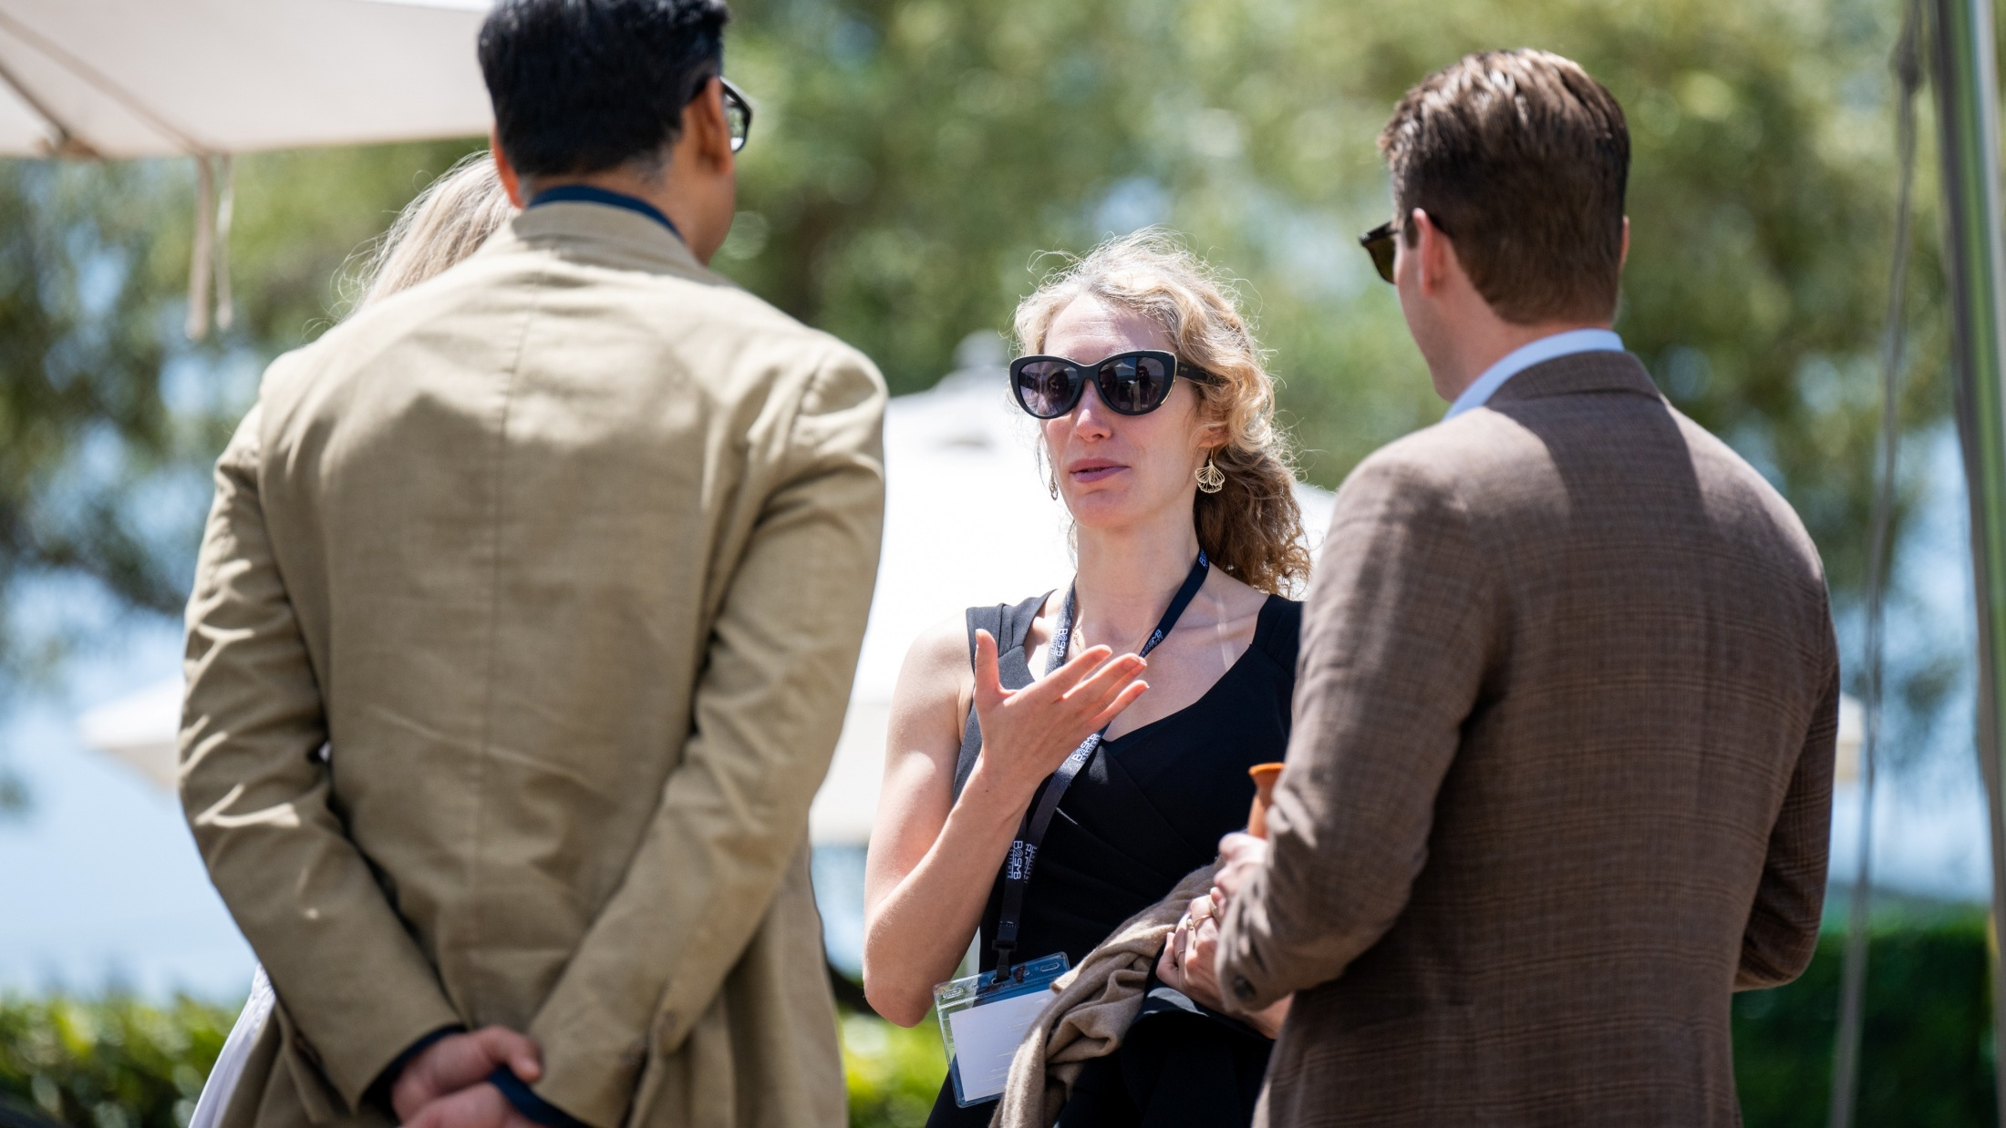
2024

Slide 16
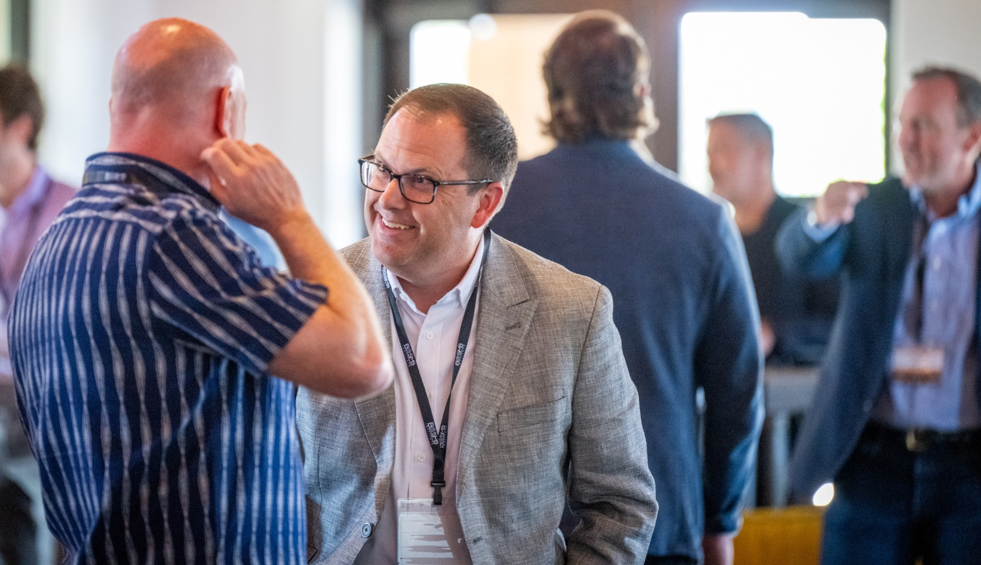

Slide 17
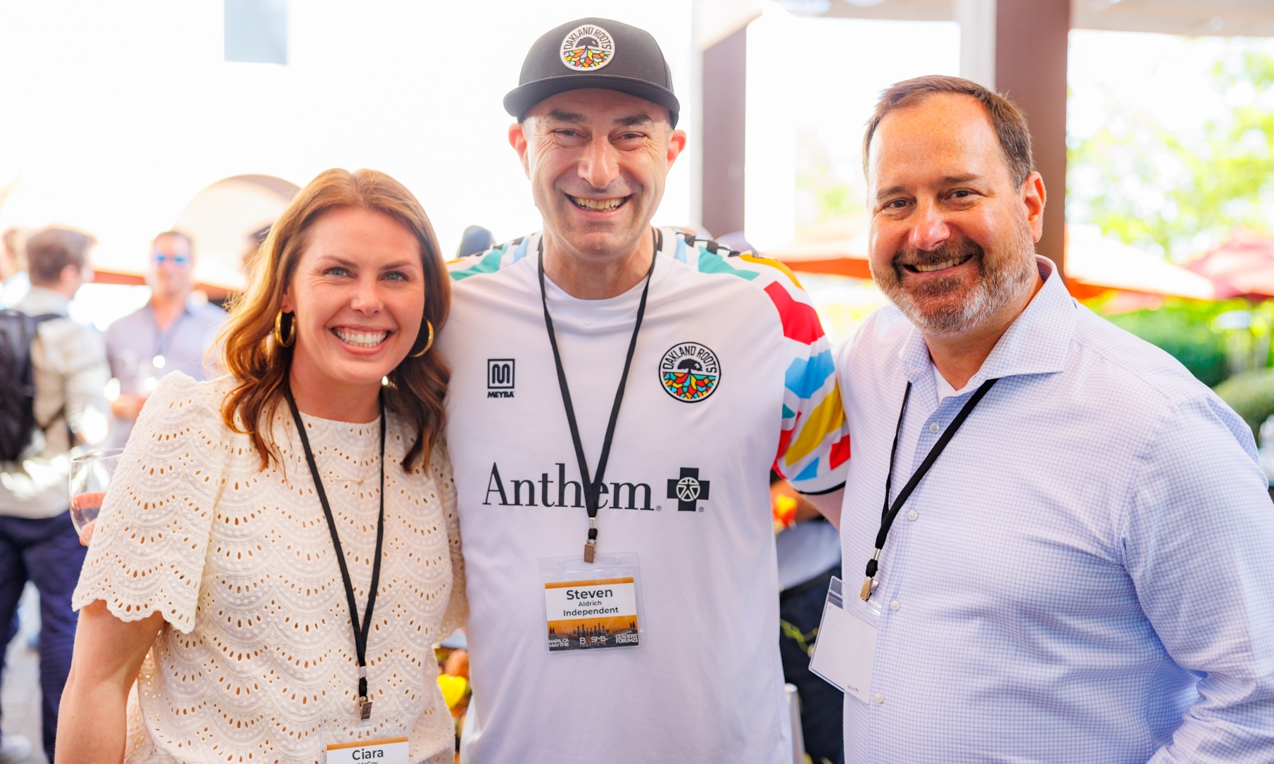

Slide 18
Melinda Emerson
The SmallBiz Lady

Slide 24
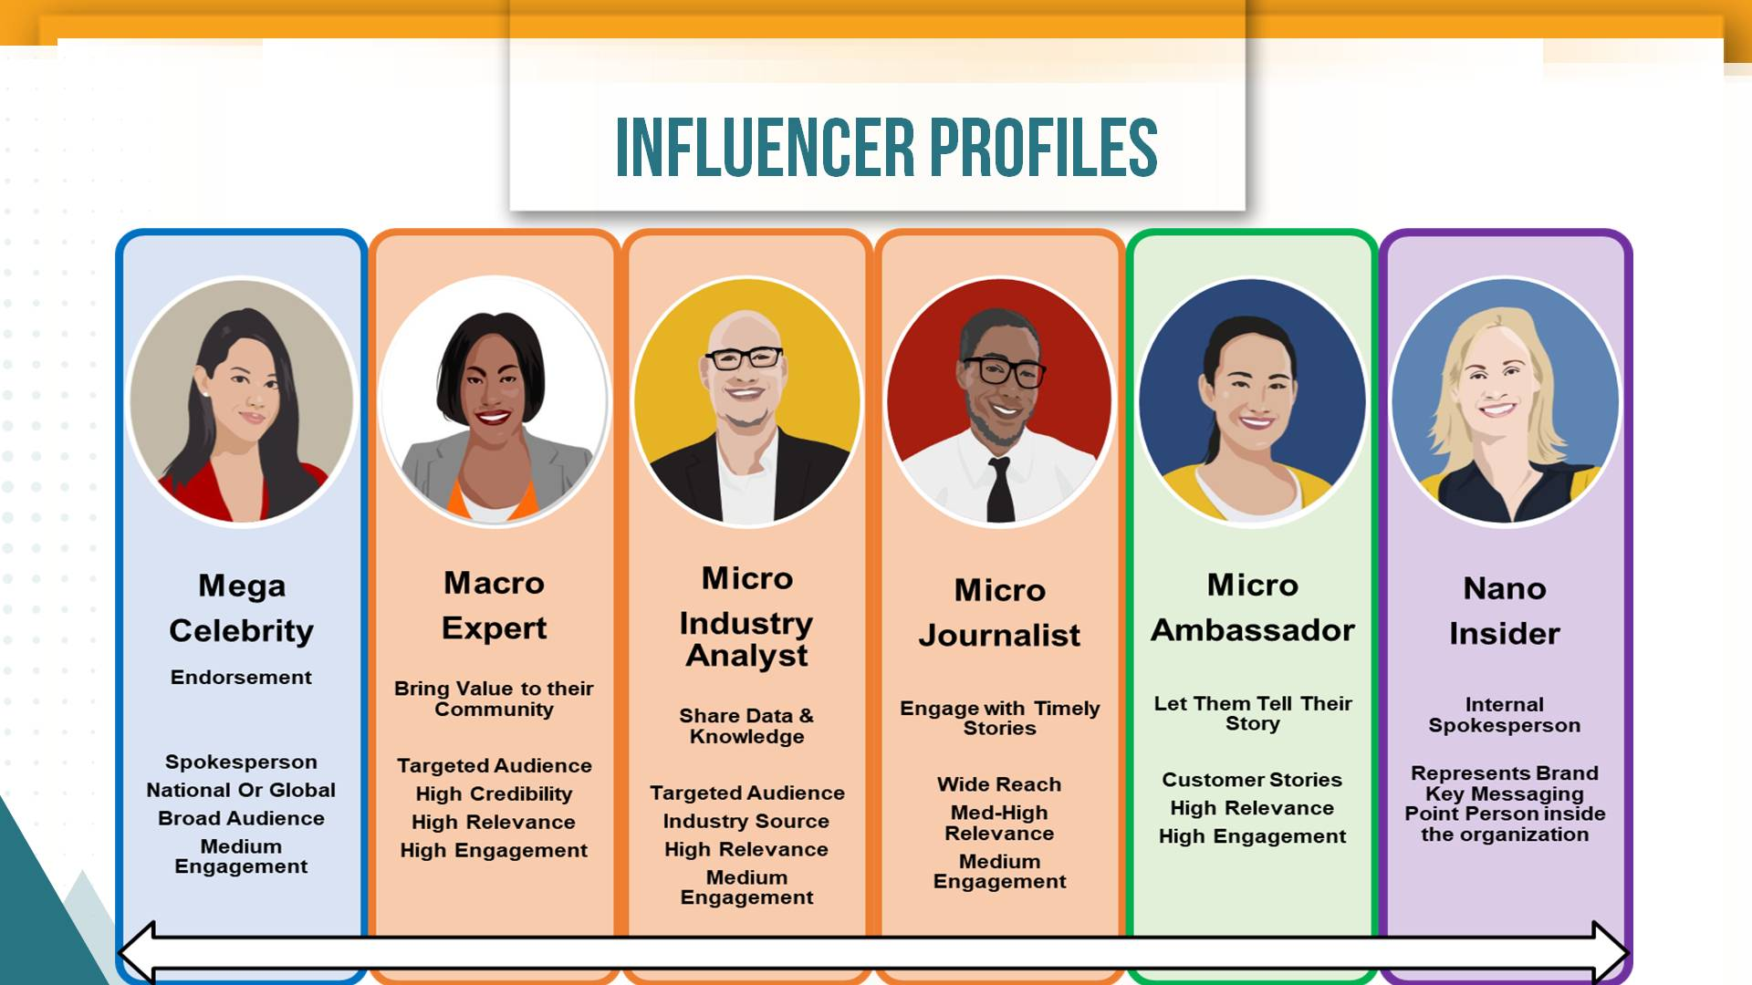

Slide 36
succeedasyourownboss.com

Slide 37
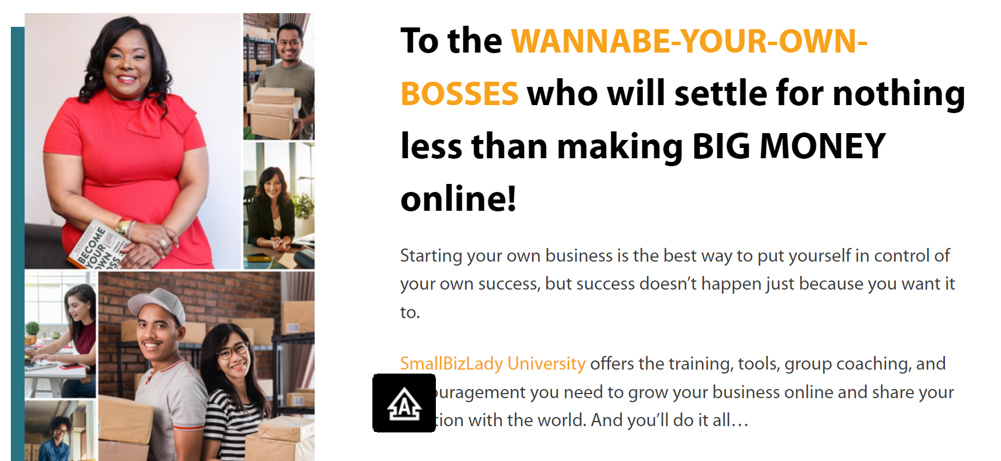
smallbizladyuniversity.com

Slide 38
Q & A

Slide 39
SHOWCASE

Slide 40
David Adams
Vensure

Slide 55
Q & A

Slide 56
Christine Telyan
UENI

Slide 70
Q & A

Slide 71
Kevin Clark
Synup

Slide 72
Q & A

Slide 73
Brinda Swanson
H&R Block

Slide 74
Q & A

Slide 75
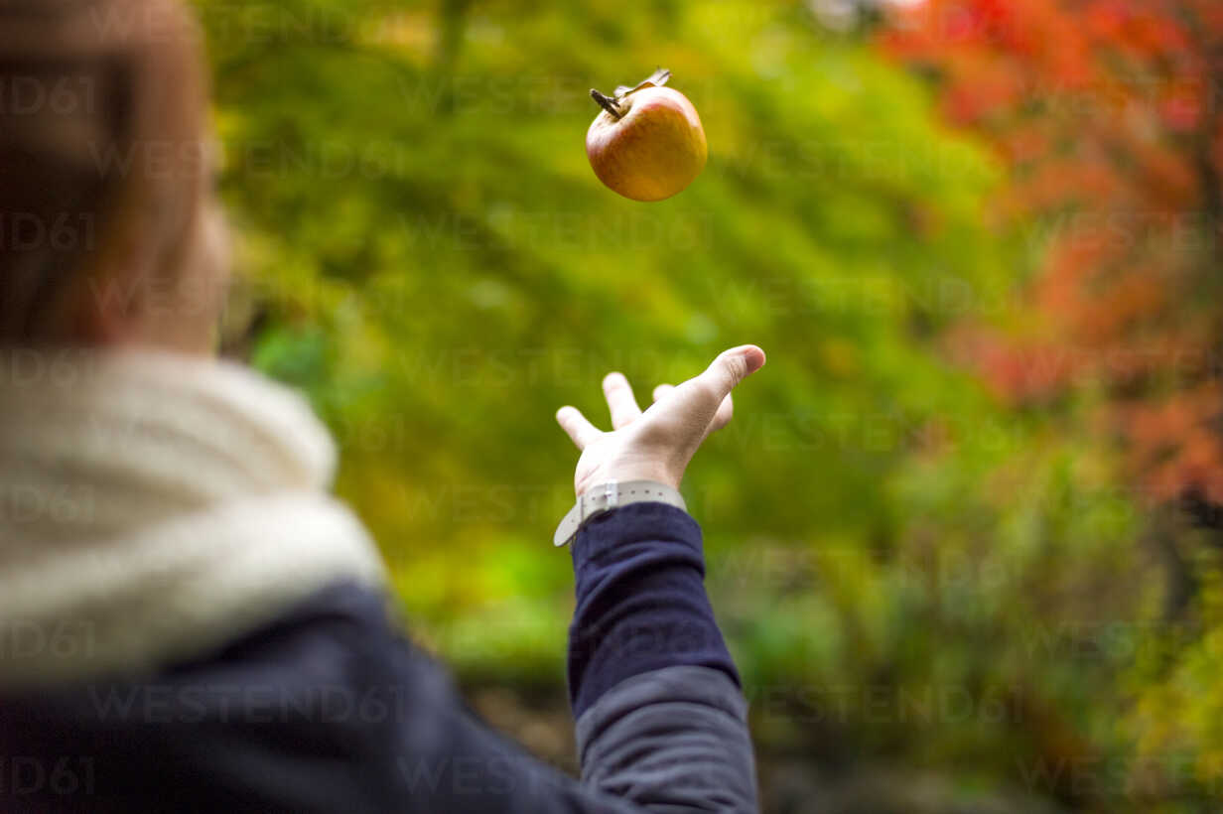
PITCH 4 PARTNERS

Slide 76
3 Minutes
Looking for?
Offering Back?

Slide 77
WALKABOUT
Objective: to meet & make plans to follow-up
with as many of your fellow Partnership Leaders
as remaining time allows.

Slide 78
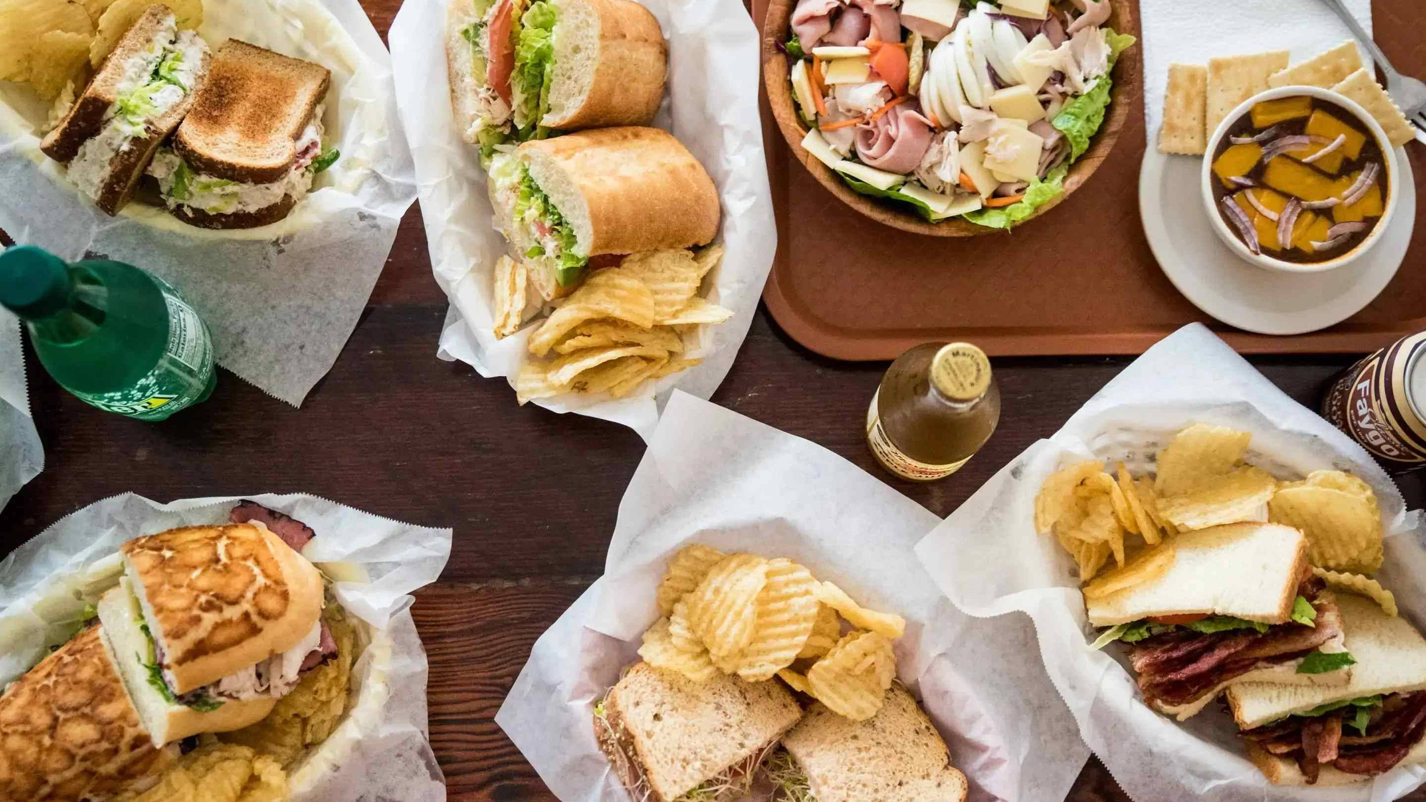

Slide 79
LEADERS’ FORUM
SONOMA, MAY 14-15

Slide 80
BEST2SMB 24

